Slide 1
Distributed Database Design

Slide 2
Storage Disk

Slide 3
Select *
From T1,T2
Where C=c1
T1 X T2
C=c1
JOIN
1 milion x 100 million

Slide 4
Database Development Lifecycle
Requirements Analysis: SRS
Design: Design Document (E-R Model, E-R to Relational)
Implementation: Software ( DDL, DML)
Testing
Installation
Maintenance

Slide 5
Outline
Introduction
Background
Distributed Database Design
Fragmentation
Data distribution
Database Integration
Semantic Data Control
Distributed Query Processing
Multidatabase Query Processing
Distributed Transaction Management
Data Replication
Parallel Database Systems
Distributed Object DBMS
Peer-to-Peer Data Management
Web Data Management
Current Issues

Slide 6
Design Problem
In the general setting :
Making decisions about the placement of data and programs across the sites of a computer network as well as possibly designing the network itself.
In Distributed DBMS, the placement of applications entails
placement of the distributed DBMS software; and
placement of the applications that run on the database

Slide 7
Dimensions of Distributed Systems (Levin and Morgan 1975)
Organization of distributed system can be investigated along three orthogonal dimensions:
Level of sharing
No sharing, data sharing, data-plus-program sharing
Behavior of access patterns
Static, Dynamic
Level of knowledge on access pattern behaviour
Partial Information, Complete Information

Slide 8
Level of Sharing
No Sharing
each application and its data execute at one site.
There is no communication with any other program or access to any data file at other sites.
Data Sharing
All the programs are replicated at all the sites, but data files are not
User requests are handled at the site where they originate and the necessary files are moved around network
Heterogeneous systems find it difficult to execute program on different hardware and O/S, but can move data easily
Data-plus-program Sharing
Both data and programs may be shared
Program at a given site can request service from another program at other site which may need to access data at a third site

Slide 9
Dimensions of the Problem
Access pattern behavior
dynamic
static
partial
information
data
Level of knowledge
data +
program
complete
information
Level of sharing

Slide 10
Distribution Design
Top-down
mostly in designing systems from scratch
mostly in homogeneous systems
Bottom-up
when the databases already exist at a number of sites

Slide 11
Database Development Lifecycle
Requirements Analysis: SRS
Design: Design Document (E-R Model, E-R to Relational)
Implementation: Software ( DDL, DML)
Testing
Installation
Maintenance

Slide 12
Top-Down Design
Requirements
Analysis
Objectives
User Input
Conceptual
Design
View Integration
View Design
GCS
Access
Information
ES’s
Distribution
Design
User Input
LCS’s
Physical
Design
LIS’s

Slide 13
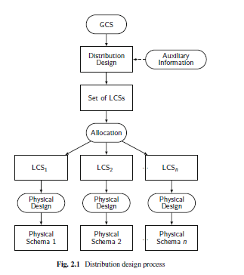
Distribution Design Process

Slide 14
Distribution Design
Global Conceptual Schema GCS: logical structure of the data at all sites
Local Conceptual Schema LCS:
External Schema ESs:

Slide 15
Distribution Design Issues
Why fragment at all?
How to fragment?
How much to fragment?
How to test correctness?
How to allocate?
Information requirements?

Slide 16
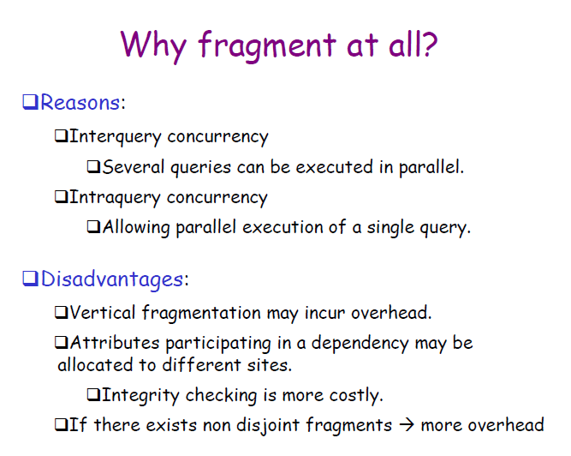

Slide 17
Fragmentation
Can't we just distribute relations?
What is a reasonable unit of distribution?
relation
views are subsets of relations ➔locality
extra communication
fragments of relations (sub-relations)
concurrent execution of a number of transactions that access different portions of a relation
views that cannot be defined on a single fragment will require extra processing
semantic data control (especially integrity enforcement) more difficult

Slide 18
Fragmentation Alternatives – Horizontal
PROJ
PROJ₁ : projects with budgets less than $200,000
PROJ₂ : projects with budgets greater than or equal to $200,000
PNO
PNAME
BUDGET
LOC
P1
Instrumentation
150000
Montreal
P2
Database Develop.
135000
New York
P3
CAD/CAM
250000
New York
P4
Maintenance
310000
Paris
P5
CAD/CAM
500000
Boston
PROJ₁
PROJ₂
PNO
PNAME
BUDGET
LOC
PNO
PNAME
BUDGET
LOC
P1
Instrumentation
150000
Montreal
P3
CAD/CAM
250000
New York
P2
Database Develop.
135000
New York
P4
Maintenance
310000
Paris
P5
CAD/CAM
500000
Boston

Slide 19
Fragmentation Alternatives – Vertical
PROJ
PROJ₁: information about project budgets
PROJ₂: information about project names and locations
PNO
PNAME
BUDGET
LOC
P1
Instrumentation
150000
Montreal
P2
Database Develop.
135000
New York
P3
CAD/CAM
250000
New York
P4
Maintenance
310000
Paris
P5
CAD/CAM
500000
Boston
PROJ₁
PROJ₂
PNO
BUDGET
PNO
PNAME
LOC
P1
150000
P1
Instrumentation
Montreal
P2
135000
P2
Database Develop.
New York
P3
250000
P3
CAD/CAM
New York
P4
310000
P4
Maintenance
Paris
P5
500000
P5
CAD/CAM
Boston

Slide 20
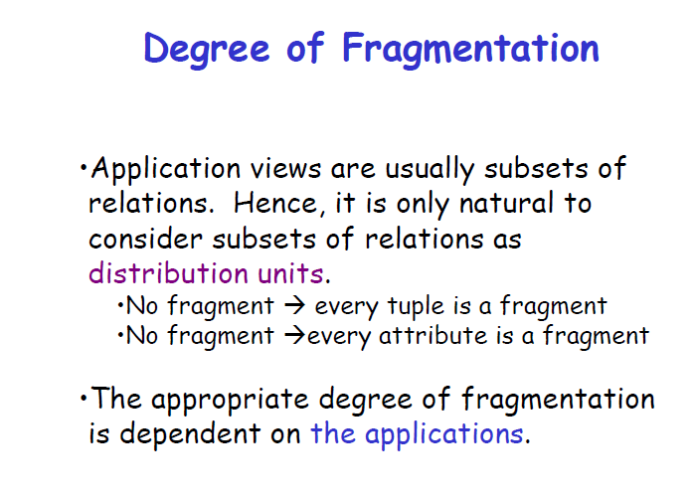

Slide 21
Degree of Fragmentation
finite number of alternatives
tuples
or
attributes
relations
Finding the suitable level of partitioning within this range

Slide 22
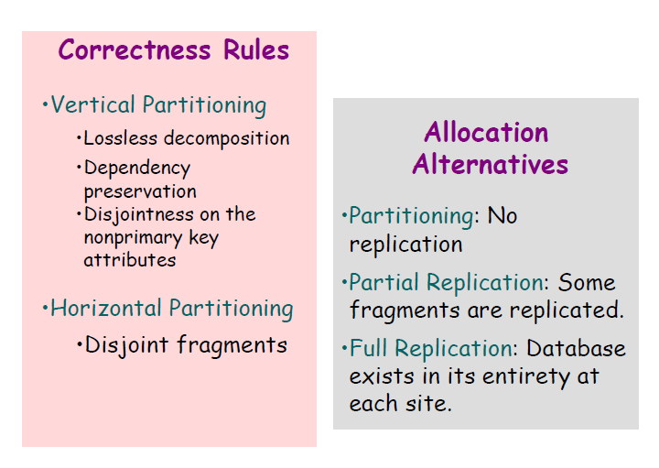

Slide 23
Correctness of Fragmentation
Completeness
Decomposition of relation R into fragments R₁, R₂, ..., R_{n} is complete if and only if each data item in R can also be found in some R_{i}
Reconstruction
If relation R is Decomposed into fragments R₁, R₂, ..., R_{n}, then there should exist some relational operator ∇ such that
R = ∇_{1≤i≤n}R_{i}
Reconstructability of R from fragments ensures that constraints defined on the data in the form of the dependencies are preserved.
Disjointness
If relation R is decomposed into fragments R₁, R₂, ..., R_{n}, and data item d_{i} is in R_{j}, then d_{i} should not be in any other fragment R_{k} (k ≠ j ).
For HP : fragments are disjoint
For VP: fragments are disjoint on non primary key attributes of the relation as key attributes are repeated in all the fragments.

Slide 24
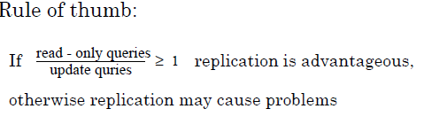
Allocation Alternatives
Non-replicated
partitioned : each fragment resides at only one site
Replicated
fully replicated : each fragment at each site
partially replicated : each fragment at some of the sites
Reliability and efficiency of read only queries

Slide 25
Purpose of Replication
System Availability : data is available even when some site is down.
Performance : replication enables the queries to locate the data closer to its access point.
Scalability : systems grow in number of sites and also distributed sites. Replication offers acceptable response times.
Application Requirements : applications may require to maintain multiple copies of the data as per its operational specifications.

Slide 26
Replication Issues
One logical and several physical copies of data item
Synchronization of replicated copies.
Partially replicated databases have local ( on non replicated data) and global (on replicated data) transactions.
Database consistency: When update transaction commites
strong consistency criteria (when all the replicas are consistent)
Weak consistency criteria (not all replicas are consistent)
Where the updates are performed?
Master copy first ( centralized) – single master database or primary copy of each data item is different
Any replica first (distributed)

Slide 27
Replication Issues (2)
Update propagation can be eager (individual update or batch write is pushed) or lazy.
Replication transparency:
Limited replication transparency - Application requires to know the master site for
submitting transaction operations
Full replication transparency – user applications submit transactions to their local Transaction manager rather than the master site

Slide 28
Comparison of Replication Alternatives
Full-replication
Partial-replication
Partitioning
QUERY
PROCESSING
Easy
Same Difficulty
DIRECTORY
MANAGEMENT
Easy or
Non-existant
Same Difficulty
CONCURRENCY
CONTROL
Moderate
Difficult
Easy
RELIABILITY
Very high
High
Low
REALITY
Possible
application
Realistic
Possible
application

Slide 29
Fragmentation
Horizontal Fragmentation (HF)
Partitions relation along its tuples
Primary Horizontal Fragmentation (PHF) is performed using predicates defined on that relation.
Derived Horizontal Fragmentation (DHF) is performed based on predicates defined on another relation.
Vertical Fragmentation (VF)
Hybrid Fragmentation (HyF)

Slide 30
Information Requirements
Four categories:
Database information - logical organization of database
Application information - location of applications
Communication network information - access characteristics of the applications to the database (quantitative, used in allocation models)
Computer system information - properties or capabilities of computer systems at each site (quantitative, used in allocation models)

Slide 31
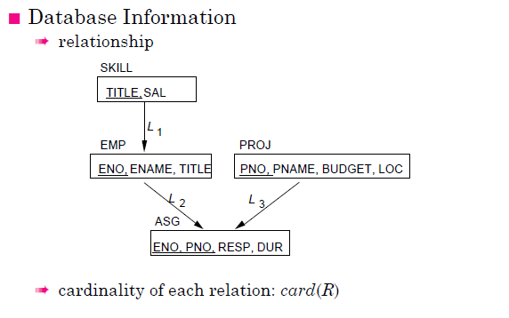

Slide 32
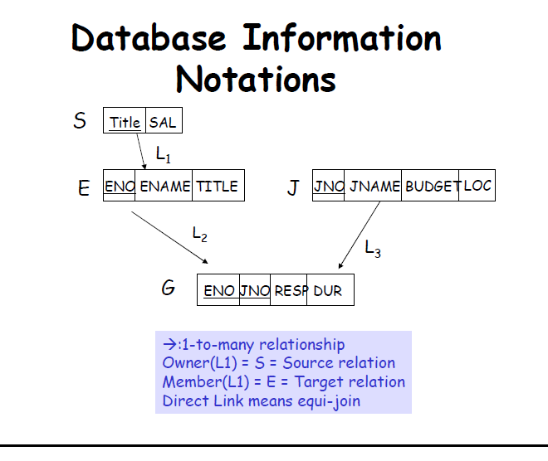

Slide 33
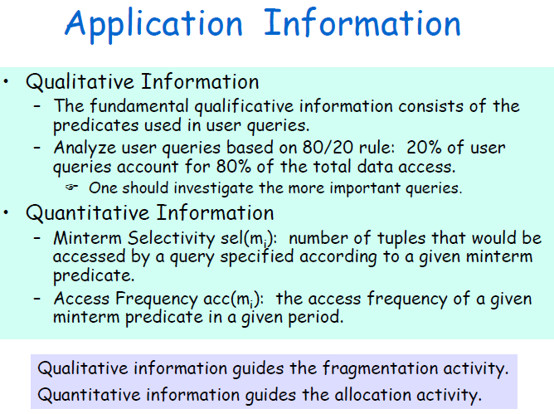

Slide 34
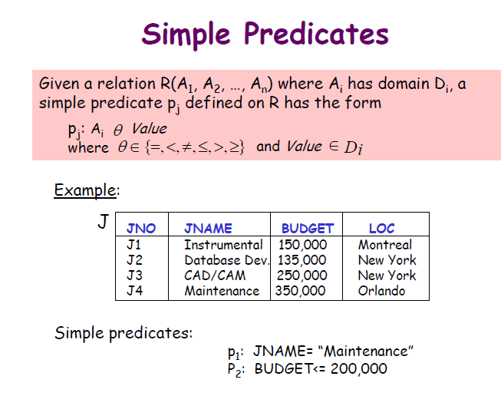

Slide 35
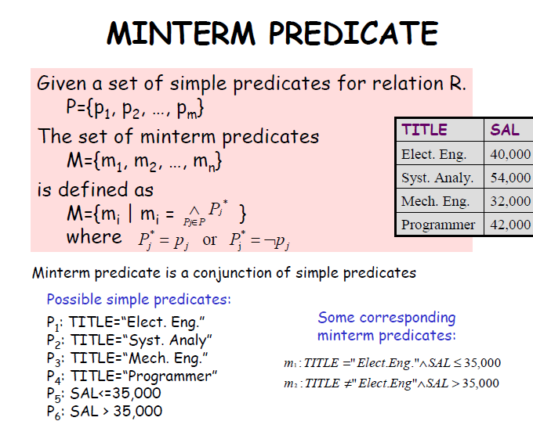

Slide 36
PHF - Information Requirements
Application Information
simple predicates : Given R[A₁, A₂, …, A_{n}], a simple predicate p_{j} is
p_{j} : A_{i} θValue
where θ ∈ {=,<,≤,>,≥,≠}, Value ∈ D_{i} and D_{i} is the domain of A_{i}.
For relation R we define Pr = {p₁, p₂, …,p_{m}}
Example :
PNAME = "Maintenance"
BUDGET ≤ 200000
minterm predicates : Given R and Pr = {p₁, p₂, …,p_{m}}
define M = {m₁,m₂,…,m_{r}} as
M = { m_{i} | m_{i} = ∧_{pj∈Pr} p_{j}* }, 1≤j≤m, 1≤i≤z
where p_{j}* = p_{j} or p_{j}* = ¬(p_{j}).

Slide 37
PHF – Information Requirements
Example
m₁: PNAME="Maintenance" ∧ BUDGET≤200000
m₂: NOT(PNAME="Maintenance") ∧ BUDGET≤200000
m₃: PNAME= "Maintenance" ∧ NOT(BUDGET≤200000)
m₄: NOT(PNAME="Maintenance") ∧ NOT(BUDGET≤200000)

Slide 38
PHF – Information Requirements
Application Information
minterm selectivities: sel(m_{i})
The number of tuples of the relation that would be accessed by a user query which is specified according to a given minterm predicate m_{i}.
access frequencies: acc(q_{i})
The frequency with which a user application qi accesses data.
Access frequency for a minterm predicate can also be defined.

Slide 39
Primary Horizontal Fragmentation
Definition :
R_{j} = σ_{Fj}(R), 1 ≤ j ≤ w
where F_{j} is a selection formula, which is (preferably) a minterm predicate.
Therefore,
A horizontal fragment R_{i} of relation R consists of all the tuples of R which satisfy a minterm predicate m_{i}.
⬇
Given a set of minterm predicates M, there are as many horizontal fragments of relation R as there are minterm predicates.
Set of horizontal fragments also referred to as minterm fragments.

Slide 40
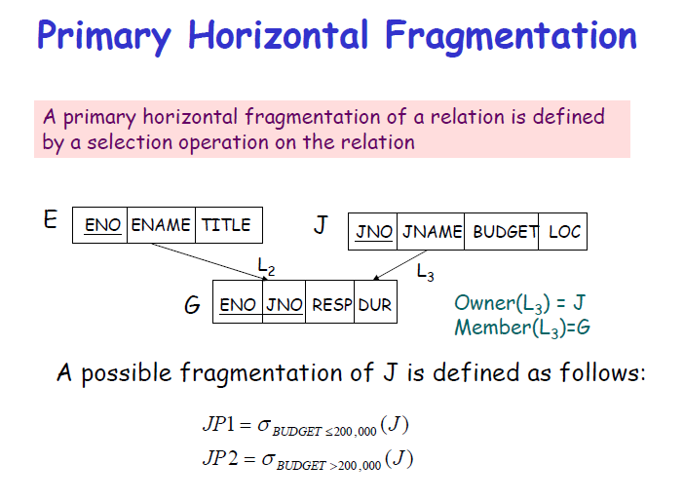

Slide 41
PHF – Algorithm
Given: A relation R, the set of simple predicates Pr
Output: The set of fragments of R = {R₁, R₂,…,R_{w}} which obey the fragmentation rules.
Preliminaries :
Pr should be complete
A set of simple predicates Pr is said to be complete if and only if there is an equal probability of access by every application to any tuple belonging to any minterm fragment that is defined according to Pr.
Pr should be minimal

Slide 42
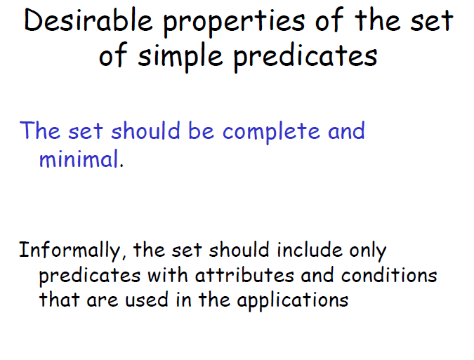

Slide 43
Completeness of Simple Predicates
A set of simple predicates Pr is said to be complete if and only if the accesses to the tuples of the minterm fragments defined on Pr requires that two tuples of the same minterm fragment have the same probability of being accessed by any application.
Example :
Assume PROJ[PNO,PNAME,BUDGET,LOC] has two applications defined on it.
Find the budgets of projects at each location. (1)
Find projects with budgets less than $200000. (2)

Slide 44
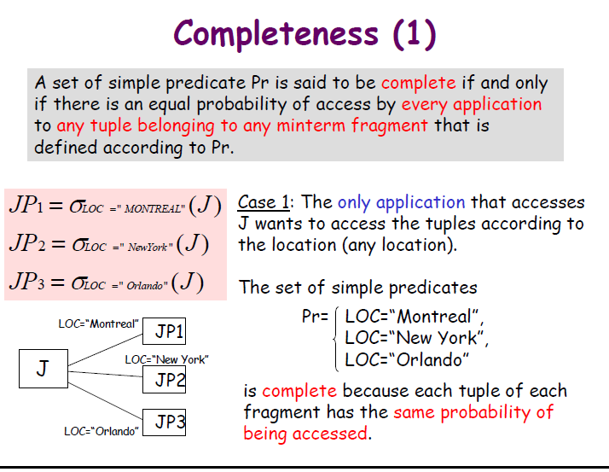

Slide 45
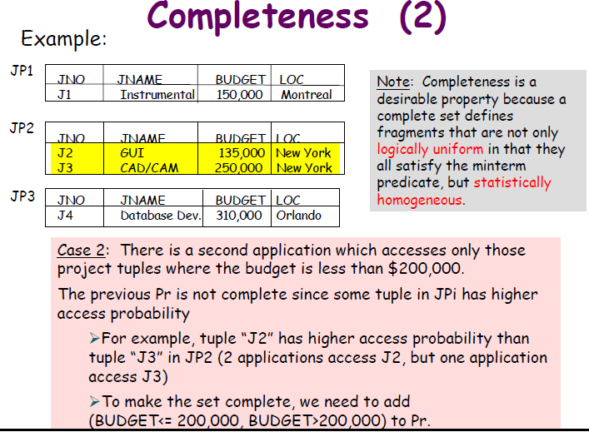

Slide 46
Completeness of Simple Predicates
According to (1),
Pr={LOC=“Montreal”,LOC=“New York”,LOC=“Paris”}
which is not complete with respect to (2).
Modify
Pr ={LOC=“Montreal”,LOC=“New York”,LOC=“Paris”, BUDGET≤200000,BUDGET>200000}
which is complete.
Resulting fragments result in a balanced load across all the fragments.

Slide 47
Minimality of Simple Predicates
If a predicate influences how fragmentation is performed, (i.e., causes a fragment f to be further fragmented into, say, f_{i} and f_{j}) then there should be at least one application that accesses f_{i} and f_{j} differently.
In other words, the simple predicate should be relevant in determining a fragmentation.
If all the predicates of a set Pr are relevant, then Pr is minimal.

Slide 48
Minimality of Simple Predicates
Example :
Pr ={LOC=“Montreal”,LOC=“New York”, LOC=“Paris”,
BUDGET≤200000,BUDGET>200000}
is minimal (in addition to being complete). However, if we add
PNAME = “Instrumentation”
then Pr is not minimal.

Slide 49
COM_MIN Algorithm
Given: a relation R and a set of simple predicates Pr
Output: a complete and minimal set of simple predicates Pr' for Pr
Rule 1: a relation or fragment is partitioned into at least two parts which are accessed differently by at least one application.

Slide 50
COM_MIN Algorithm
Initialization :
find a p_{i} ∈ Pr such that p_{i} partitions R according to Rule 1
set Pr' = p_{i} ; Pr ←Pr – {p_{i}} ; F ← {f_{i}}
Iteratively add predicates to Pr' until it is complete
find a p_{j} ∈ Pr such that p_{j} partitions some f_{k} defined according to minterm predicate over Pr' according to Rule 1
set Pr' = Pr' ∪ {p_{i}}; Pr ←Pr – {p_{i}}; F ← F ∪ {f_{i}}
if ∃p_{k} ∈ Pr' which is nonrelevant then
Pr' ← Pr – {p_{i}}
F ← F – {f_{i}}

Slide 51
PHORIZONTAL Algorithm
Makes use of COM_MIN to perform fragmentation.
Input: a relation R and a set of simple predicates Pr
Output: a set of minterm predicates M according to which relation R is to be fragmented
Pr' ← COM_MIN (R,Pr)
determine the set M of minterm predicates
determine the set I of implications among p_{i} ∈ Pr
eliminate the contradictory minterms from M

Slide 52
PHF – Example
Two candidate relations : PAY and PROJ.
Fragmentation of relation PAY
Application: Check the salary info and determine raise.
Employee records kept at two sites ⇒ application run at two sites
Simple predicates
p₁ : SAL ≤ 30000
p₂ : SAL > 30000
Pr = {p₁,p₂} which is complete and minimal Pr'=Pr
Minterm predicates
m₁ : (SAL ≤ 30000)
m₂ : NOT(SAL ≤ 30000) = (SAL > 30000)

Slide 53
PHF – Example
PAY₁
PAY₂
TITLE
SAL
TITLE
SAL
Mech. Eng.
27000
Elect. Eng.
40000
Programmer
24000
Syst. Anal.
34000

Slide 54
PHF – Example
Fragmentation of relation PROJ
Applications:
Find the name and budget of projects given their no.
Issued at three sites
Access project information according to budget
one site accesses ≤200000 other accesses >200000
Simple predicates
For application (1)
p₁ : LOC = “Montreal”
p₂ : LOC = “New York”
p₃ : LOC = “Paris”
For application (2)
p₄ : BUDGET ≤ 200000
p₅ : BUDGET > 200000
Pr = Pr' = {p₁,p₂,p₃,p₄,p₅}

Slide 55
PHF – Example
Fragmentation of relation PROJ continued
Minterm fragments left after elimination
m₁ : (LOC = “Montreal”) ∧ (BUDGET ≤ 200000)
m₂ : (LOC = “Montreal”) ∧ (BUDGET > 200000)
m₃ : (LOC = “New York”) ∧ (BUDGET ≤ 200000)
m₄ : (LOC = “New York”) ∧ (BUDGET > 200000)
m₅ : (LOC = “Paris”) ∧ (BUDGET ≤ 200000)
m₆ : (LOC = “Paris”) ∧ (BUDGET > 200000)

Slide 56
PHF – Example
PROJ₁
PROJ₂
PNO
PNAME
BUDGET
LOC
PNO
PNAME
BUDGET
LOC
P1
Instrumentation
150000
Montreal
P2
Database
Develop.
135000
New York
PROJ₄
PROJ₆
PNO
PNAME
BUDGET
LOC
PNO
PNAME
BUDGET
LOC
P3
CAD/CAM
250000
New York
P4
Maintenance
310000
Paris

Slide 57
PHF – Correctness
Completeness
Since Pr' is complete and minimal, the selection predicates are complete
Reconstruction
If relation R is fragmented into F_{R} = {R₁,R₂,…,R_{r}}
R = ∪_{∀Ri ∈FR} R_{i}
Disjointness
Minterm predicates that form the basis of fragmentation should be mutually exclusive.

Slide 58
Derived Horizontal Fragmentation
Defined on a member relation of a link according to a selection operation specified on its owner.
Each link is an equijoin.
Equijoin can be implemented by means of semijoins.
SKILL
TITLE,
SAL
L₁
EMP
PROJ
ENO, ENAME, TITLE
PNO, PNAME, BUDGET, LOC
L₂
L₃
ASG
ENO, PNO,
RESP, DUR

Slide 59
DHF – Definition
Given a link L where owner(L)=S and member(L)=R, the derived horizontal fragments of R are defined as
R_{i} = R ⋉_{F} S_{i}, 1≤i≤w
where w is the maximum number of fragments that will be defined on R and
S_{i} = σ_{Fi} (S)
where F_{i} is the formula according to which the primary horizontal fragment S_{i} is defined.

Slide 60
DHF – Example
Given link L₁ where owner(L₁)=SKILL and member(L₁)=EMP
EMP₁ = EMP ⋉ SKILL₁
EMP₂ = EMP ⋉ SKILL₂
where
SKILL₁ = σ_{SAL≤30000}(SKILL)
SKILL₂ = σ_{SAL>30000}(SKILL)
EMP₁
EMP₂
ENO
ENAME
TITLE
ENO
ENAME
TITLE
E3
A. Lee
Mech. Eng.
E1
J. Doe
Elect. Eng.
E4
J. Miller
Programmer
E2
M. Smith
Syst. Anal.
E7
R. Davis
Mech. Eng.
E5
B. Casey
Syst. Anal.
E6
L. Chu
Elect. Eng.
E8
J. Jones
Syst. Anal.

Slide 61
DHF – Correctness
Completeness
Referential integrity
Let R be the member relation of a link whose owner is relation S which is fragmented as F_{S} = {S₁, S₂, ..., S_{n}}. Furthermore, let A be the join attribute between R and S. Then, for each tuple t of R, there should be a tuple t' of S such that
t[A] = t' [A]
Reconstruction
Same as primary horizontal fragmentation.
Disjointness
Simple join graphs between the owner and the member fragments.

Slide 62
Vertical Fragmentation
Has been studied within the centralized context
design methodology
physical clustering
More difficult than horizontal, because more alternatives exist.
Two approaches :
grouping
attributes to fragments
splitting
relation to fragments

Slide 63
Vertical Fragmentation
Overlapping fragments
grouping
Non-overlapping fragments
splitting
We do not consider the replicated key attributes to be overlapping.
Advantage:
Easier to enforce functional dependencies
(for integrity checking etc.)

Slide 64
VF – Information Requirements
Application Information
Attribute affinities
a measure that indicates how closely related the attributes are
This is obtained from more primitive usage data
Attribute usage values
Given a set of queries Q = {q₁, q₂,…, q_{q}} that will run on the relation R[A₁, A₂,…, A_{n}],
use(q_{i},•) can be defined accordingly
⎧
1 if attribute A_{j} is referenced by query q_{i}
use(q_{i},A_{j}) =
⎨
⎩
0 otherwise

Slide 65
VF – Definition of use(q_{i},A_{j})
Consider the following 4 queries for relation PROJ
q₁: SELECT BUDGET q₂: SELECT PNAME,BUDGET
FROM PROJ FROM PROJ
WHERE PNO=Value
q₃: SELECT PNAME q₄: SELECT SUM(BUDGET)
FROM PROJ FROM PROJ
WHERE LOC=Value WHERE LOC=Value
Let A₁= PNO, A₂= PNAME, A₃= BUDGET, A₄= LOC
A₁
A₂
A₃
A₄
q₁
1
0
1
0
q₂
0
1
1
0
q₃
0
1
0
1
q₄
0
0
1
1

Slide 66
VF – Affinity Measure aff(A_{i},A_{j})
The attribute affinity measure between two attributes A_{i} and A_{j} of a relation R[A₁, A₂, …, A_{n}] with respect to the set of applications Q = (q₁, q₂, …, q_{q}) is defined as follows :
∑
aff (A_{i}, A_{j}) =
(query access)
all queries that access A_{i} and A_{j}
∑
access
query access =
access frequency of a query ∗
execution
all sites

Slide 67
VF – Calculation of aff(A_{i}, A_{j})
S
S
S
1
2
3
q
15
20
10
1
q
5
0
0
2
q
25
25
25
3
q
4
3
0
0
A
A
A
A
1
2
3
4
A
45
0
45
0
1
A
0
80
5
75
2
A
45
5
53
3
3
A
0
75
3
78
4

Slide 68
VF – Clustering Algorithm
Take the attribute affinity matrix AA and reorganize the attribute orders to form clusters where the attributes in each cluster demonstrate high affinity to one another.
Bond Energy Algorithm (BEA) has been used for clustering of entities. BEA finds an ordering of entities (in our case attributes) such that the global affinity measure is maximized.
AM =
∑
∑
(affinity of A_{i} and A_{j} with their neighbors)
i
j

Slide 69
Bond Energy Algorithm
Input: The AA matrix
Output: The clustered affinity matrix CA which is a perturbation of AA
Initialization: Place and fix one of the columns of AA in CA.
Iteration: Place the remaining n-i columns in the remaining i+1 positions in the CA matrix. For each column, choose the placement that makes the most contribution to the global affinity measure.
Row order: Order the rows according to the column ordering.

Slide 70
Bond Energy Algorithm
“Best” placement? Define contribution of a placement:
cont(A_{i}, A_{k}, A_{j}) = 2bond(A_{i}, A_{k})+2bond(A_{k}, A_{l}) –2bond(A_{i}, A_{j})
where
n
∑
aff(A_{z},A_{x})aff(A_{z},A_{y})
bond(A_{x},A_{y}) =
z =1

Slide 71
BEA – Example
Consider the following AA matrix and the corresponding CA matrix where A₁ and A₂ have been placed. Place A₃:
Ordering (0-3-1) :
cont(A₀,A₃,A₁) = 2bond(A₀ , A₃)+2bond(A₃ , A₁)–2bond(A₀ , A₁)
= 2* 0 + 2* 4410 – 2*0 = 8820
Ordering (1-3-2) :
cont(A₁,A₃,A₂) = 2bond(A₁ , A₃)+2bond(A₃ , A₂)–2bond(A₁,A₂)
= 2* 4410 + 2* 890 – 2*225 = 10150
Ordering (2-3-4) :
cont (A₂,A₃,A₄) = 1780

Slide 72
BEA – Example
Therefore, the CA matrix has the form
When A₄ is placed, the final form of the CA matrix (after row organization) is
A₁
A₃
A₂
45
45
0
0
5
80
45
53
5
0
3
75
A₁
A₃
A₂
A₄
A₁
45
45
0
0
A₃
45
53
5
3
A₂
0
5
80
75
A₄
0
3
75
78

Slide 73
VF – Algorithm
How can you divide a set of clustered attributes {A₁, A₂, …, A_{n}} into two (or more) sets {A₁, A₂, …, A_{i}} and {A_{i}, …, A_{n}} such that there are no (or minimal) applications that access both (or more than one) of the sets.
A₁
A₂
A₃
…
A_{i}
A_{i+1}
. . .
A_{m}
A₁
A₂
. . .
TA
A_{i}
A_{i+1}
. . .
BA
A_{m}

Slide 74
VF – ALgorithm
Define
TQ = set of applications that access only TA
BQ = set of applications that access only BA
OQ = set of applications that access both TA and BA
and
CTQ = total number of accesses to attributes by applications that access only TA
CBQ = total number of accesses to attributes by applications that access only BA
COQ = total number of accesses to attributes by applications that access both TA and BA
Then find the point along the diagonal that maximizes
CTQ∗CBQ−COQ²

Slide 75
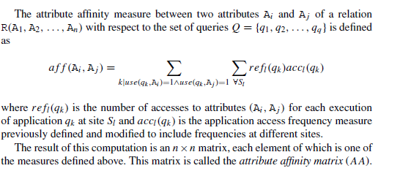
refl (qk) and accl(qk) definitions

Slide 76
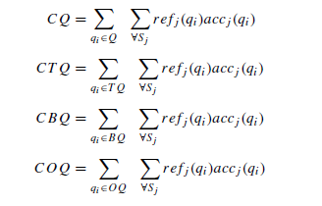
Optimization
There is an optimization problem here. If there are n attributes of a relation, there are n − 1 possible positions where the dividing point can be placed along the diagonal of the clustered attribute matrix for that relation. The best position for division is one which produces the sets TQ and BQ such that the total accesses to only one fragment are maximized, while the total accesses to both fragments are minimized. We therefore define the following cost equations:

Slide 77
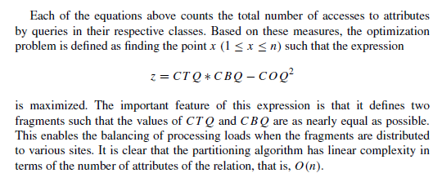

Slide 78
VF – Algorithm
Two problems :
Cluster forming in the middle of the CA matrix
Shift a row up and a column left and apply the algorithm to find the “best” partitioning point
Do this for all possible shifts
Cost O(m²)
More than two clusters
m-way partitioning
try 1, 2, …, m–1 split points along diagonal and try to find the best point for each of these
Cost O(2^{m})

Slide 79
VF – Correctness
A relation R, defined over attribute set A and key K, generates the vertical partitioning F_{R} = {R₁, R₂, …, R_{r}}.
Completeness
The following should be true for A:
A = ∪ A_{Ri}
Reconstruction
Reconstruction can be achieved by
R = ⋈_{K} R_{i}, ∀R_{i} ∈ F_{R}
Disjointness
TID's are not considered to be overlapping since they are maintained by the system
Duplicated keys are not considered to be overlapping

Slide 80
Hybrid Fragmentation
R
HF
HF
R₁
R₂
VF
VF
VF
VF
VF
R₁₁
R₁₂
R₂₁
R₂₂
R₂₃

Slide 81
Fragment Allocation
Problem Statement
Given
F = {F₁, F₂, …, F_{n}} fragments
S ={S₁, S₂, …, S_{m}} network sites
Q = {q₁, q₂,…, q_{q}} applications
Find the "optimal" distribution of F to S.
Optimality
Minimal cost
Communication + storage + processing (read & update)
Cost in terms of time (usually)
Performance
Response time and/or throughput
Constraints
Per site constraints (storage & processing)

Slide 82
Information Requirements
Database information
selectivity of fragments (how many tuples from Fj?)
size of a fragment (card*length)
Application information
access types and numbers (RRij: no of read accesses by qi to Fj), URij
access localities
Communication network information
unit cost of storing data at a site
unit cost of processing at a site
Computer system information
bandwidth
latency
communication overhead

Slide 83
Allocation
File Allocation (FAP) vs Database Allocation (DAP):
Fragments are not individual files
relationships have to be maintained
Access to databases is more complicated
remote file access model not applicable
relationship between allocation and query processing
Cost of integrity enforcement should be considered
Cost of concurrency control should be considered

Slide 84
Allocation – Information Requirements
Database Information
selectivity of fragments
size of a fragment
Application Information
number of read accesses of a query to a fragment
number of update accesses of query to a fragment
A matrix indicating which queries updates which fragments UM
A similar matrix for reads RM
originating site of each query
Site Information
unit cost of storing data at a site
unit cost of processing at a site
Network Information
communication cost/frame between two sites
frame size

Slide 85
Allocation Model
General Form
Minimising Total cost of processing plus storage keeping in mind some response time constraints.
min(Total Cost)
subject to
response time constraint
storage constraint
processing constraint
Decision Variable
1 if fragment F_{i} is stored at site S_{j}
x_{ij} =
0 otherwise

Slide 86
Allocation Model
Total Cost
Storage Cost (of fragment F_{j} at S_{k})
Query Processing Cost (for one query)
processing component + transmission component
∑
query processing cost +
all queries
∑
∑
cost of storing a fragment at a site
all sites
all fragments
(unit storage cost at S_{k}) ∗ (size of F_{j}) ∗ x_{jk}

Slide 87
Allocation Model
Query Processing Cost
Processing component
access cost + integrity enforcement cost + concurrency control cost
Access cost
Integrity enforcement and concurrency control costs
Can be similarly calculated
∑
∑
(no. of update accesses+ no. of read accesses) ∗
all sites
all fragments
x_{ij} ∗ local processing cost at a site

Slide 88
Allocation Model
Query Processing Cost
Transmission component
cost of processing updates + cost of processing retrievals
Cost of updates
Retrieval Cost
∑
∑
update message cost +
all sites
all fragments
∑
∑
acknowledgment cost
all sites
all fragments
∑
min
(cost of retrieval command +
all sites
all fragments
cost of sending back the result)

Slide 89
Allocation Model
Constraints
Response Time
execution time of query ≤ max. allowable response time for that query
Storage Constraint (for a site)
Processing constraint (for a site)
∑
storage requirement of a fragment at that site ≤
all fragments
storage capacity at that site
∑
processing load of a query at that site ≤
all queries
processing capacity of that site

Slide 90
Allocation Model
Solution Methods
A solution to NP-complete problem can be verified "quickly", there is no known way to find a solution quickly. That is, the time required to solve the problem using any currently known algorithm increases rapidly as the size of the problem grows
FAP is NP-complete
DAP also NP-complete
Heuristics based on
single commodity warehouse location (for FAP)
knapsack problem
branch and bound techniques
network flow

Slide 91
Allocation Model
Attempts to reduce the solution space
assume all candidate partitionings known; select the “best” partitioning
ignore replication at first
sliding window on fragments

